Slide 1
Robotic Flag Finder
ECE 3333/3334-302
Instructor: William Ray
Group 6: Leader - Celina
Adam Harper - Software Engineer
Celina Luckevich - Software Engineer
Joseph Mahoney - Software Engineer
Joshua Warren - Software Engineer

Slide 2
System Description
Two robots are designed to search a room for flags, retrieve the flags, and return to their home base. The robots work both cooperatively and competitively, each trying to find the most flags but ensuring all flags are found. They send video and location feed over a wifi network to a computer where instructions for driving the robots are derived from the video; these instructions are then sent back over the network to the robots. The system works autonomously, but a manual, human-controlled mode is also available.

Slide 3
Last Week Deliverables
Josh
Research Computer Vision
Research and choose robot body
Celina
Research Computer Vision
Research image processing and analysis
Research and choose ultrasonic sensor
Adam
Research Wireless connection and user interface
Research and choose camera
Joe
Research Wireless connection and user interface
Research arm and choose servo and electromagnet

Slide 4
Safety Considerations
Avoiding short circuits, causing overheating.
Careful to operate robots at a safe speed to avoid damaging parts/people
Exercise caution to avoid cuts from sharp wire ends
Covering wires when cutting to keep ends from flying
Always use proper PPE

Slide 5
Division of Labor
Josh
Rover side
Computer Vision
Celina
Rover side
Computer Vision
Image Processing and Analysis
Flag finding/Detection
Adam
Computer side
Communication between robots and computer
Communication between camera and computer
Joe
Computer side
GUI
Robotic arm

Slide 6
Block Diagram
WIFI
Physical connection
Uart
Power
GPIO
PWM
Power
Robot #2 is identical
PC
sensors
Robot #1
Ultrasonic
HC-SR04
Wifi Camera
External rechargeable battery
CC3220
MCU
mechanical
3.3 V
5 V
3.3V
3.3 Volt
Regulator
5 V Voltage
Regulator
9.6v
9.6V
2000mAh
9.6 V
9 V Voltage
Regulator
3.3v
Data Computation
3.3v 50 Hz
Dagu - Rover 5 chassis motors
5 V Voltage
Regulator
HS-422
Survo
Uxcell 9V 50N
Electromagnet
Circuits
7.2 V
H-Bridge
Joe Mahoney

Slide 7
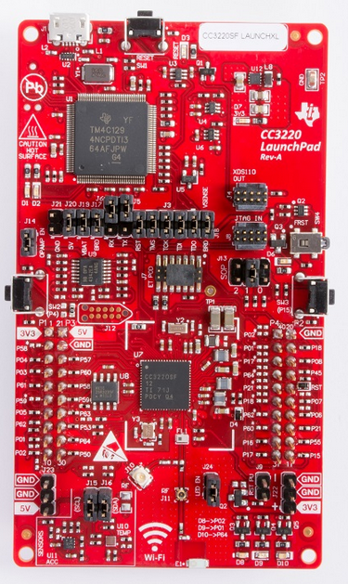
Texas Instruments CC3220SF
Wi-Fi Network Processor with static or dynamic IP address
IPv6 and TCP/IP capable
Automatic connection on startup
Ideal for IoT
Uses 5V at 0.5A supply voltage
1MB Flash, 256KB RAM
12 bit ADC
27 GPIO pins
All info from TI [6]

Slide 8
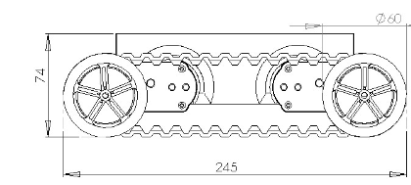
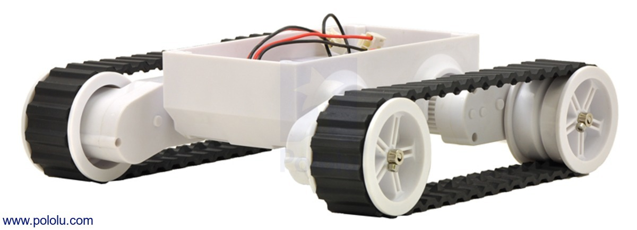
Rover Base
Dagu Rover 5
Motor Rated Voltage: 7.2V
Motor Stall Current: 2.5A
Motor Stall Torque: 10Kg/cm
Motors have 1000/3 encoders
Speed: 1Km/hr
All info from Pololu [5]

Slide 9
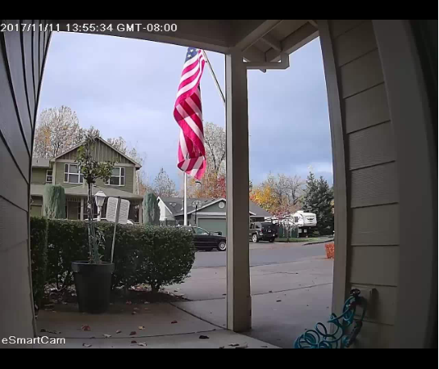
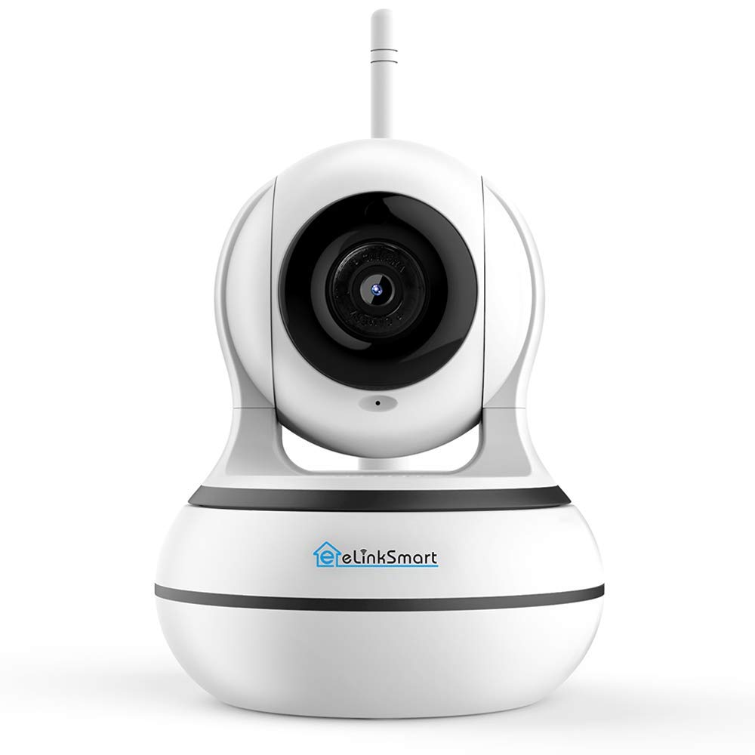
Camera - eLinkSmart
IP Camera (WIFI)
1280 x 960p
Rechargeable Battery
Can be used with app (for testing)
Connects to openCV using
camera’s IP address as input
Images from [1]

Slide 10
Arm Servo
Servo motor - HS-422
Operating voltage 4.8 V - 6 V
8mA Idle current drain
.21sec/60 degrees
Electromagnet - uxcell 9V 50N Electric Lifting Magnet
Holding force 50N / 11.2 pound force
Joe Mahoney

Slide 11
Arm Servo
Picking up flags Process
Once rover is in position the electromagnet will activate attracting the metal flag pole.
Once the flag is secure the servo will rotate a lever arm containing the electromagnet and flag. When the flag is over the bucket/ basket located on the servo side of the rover the magnet will power down releasing the flag.
The servo will then reset itself to its starting position.
Joe Mahoney

Slide 12
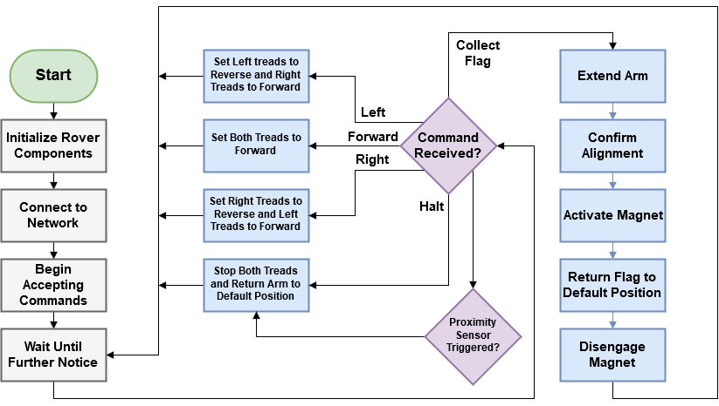
Rover Software Diagram

Slide 13
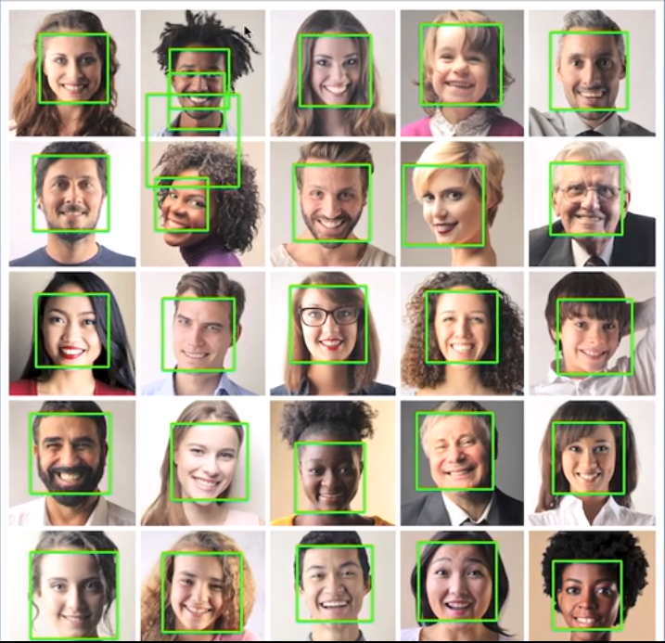
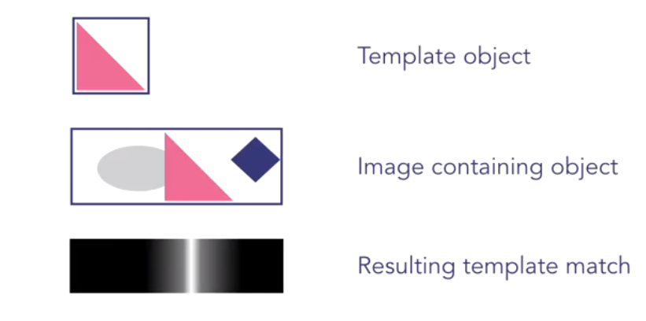
Computer Vision
Project description requires rover to use camera to view surroundings
OpenCV has video analyzing features allowing us to scan the rovers surroundings for the flags it is looking for
Different kinds of filters
Usually coded in python
[2]
[2]

Slide 14
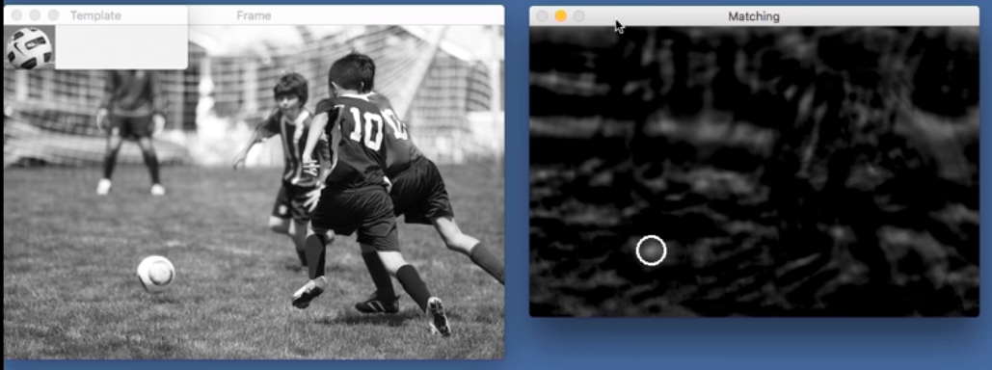
[2]

Slide 15
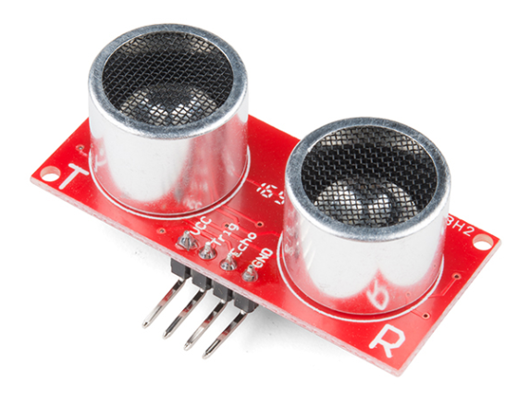
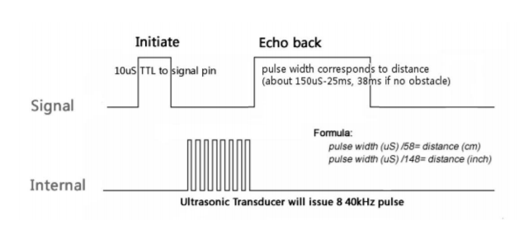
Ultrasonic Sensor - HC-SR04
Operating Voltage: 5V DC
Operating Current: 15mA
Measure Angle: 15°
Ranging Distance: 2cm - 4m
[3]
Range = uS / 58 -> centimeters
Range = uS / 148 -> inches
Range = high level time * velocity (340M/S) / 2
[3]
[4]

Slide 16
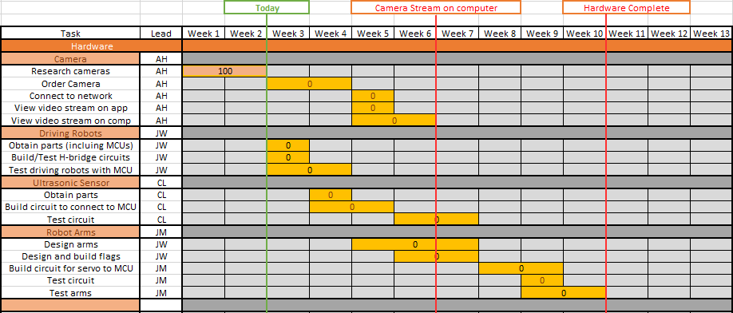

Gantt Chart - Hardware

Slide 17
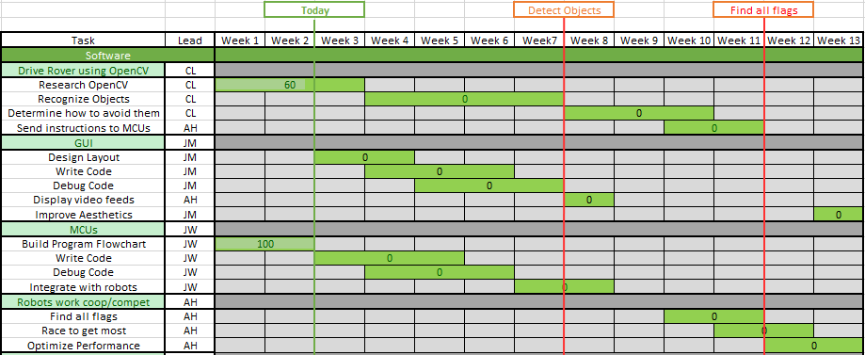
Gantt Chart - Software

Slide 18
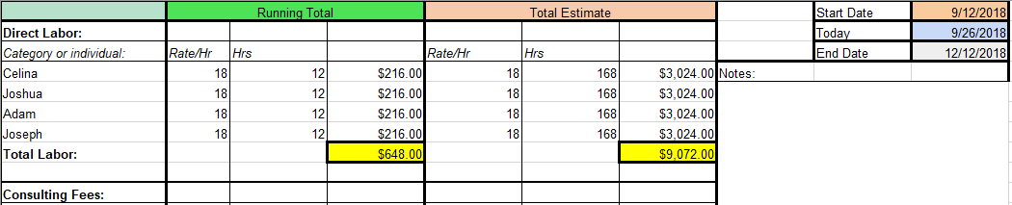
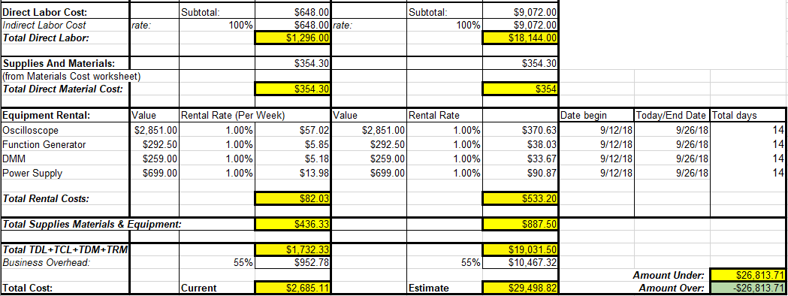
Budget

Slide 19
Next Week Deliverables
Josh
Begin simple image processing
Research into controlling the CC3220 through Wi-Fi.
Celina
Learn basic Python
Begin simple image processing and filtering codes
Adam
Research computer communication with IP Cameras
Order camera
Testing camera communication
Joe
Research creating a user interface and communicating with the CC3220 via wifi.
Look into displaying a video stream in a GUI

Slide 20
References
eLinkSmart WIFI Camera https://www.amazon.com/Wireless-Security-eLinkSmart-Recording-Detection/dp/B07414BGZC
Crawford, P. (2017). Introduction to template matching. [online] Lynda.com - from LinkedIn. Available at: https://www.lynda.com/Python-tutorials/Introduction-template-matching/601786/660495-4.html [Accessed 21 Sep. 2018].
Sparkfun.com. (2018). Ultrasonic Sensor - HC-SR04 - SEN-13959 - SparkFun Electronics. [online] Available at: https://www.sparkfun.com/products/13959 [Accessed 23 Sep. 2018].
ITead Studio. (2018). Ultrasonic ranging module : HC-SR04 data sheet. [online] Available at: https://www.electroschematics.com/wp-content/uploads/2013/07/HC-SR04-datasheet-version-2.pdf [Accessed 24 Sep. 2018].
Pololu.com. (2018). Dagu Rover 5 Tracked Chassis with Encoders. [online] Available at: https://www.pololu.com/product/1551/resources [Accessed 24 Sep. 2018].
TI.com. (2018). SimpleLink™ Wi-Fi® CC3220SF Wireless Microcontroller. [online] Available at: http://www.ti.com/lit/ds/swas035a/swas035a.pdf [Accessed 24 Sep. 2018].

Slide 21
Questions?

